Slide 1

Corporate Bankruptcy Risk Prediction with Machine Learning
Comparing Interpretable Logistic Regression and Tree-Based Models
Presentation focus
Rare failures
False alarms
Model trade-offs
Berke Pehlivan Machine Learning for Finance University of Bonn Academic Year 2025/2026
Notes:
Timing note: 0.5 minutes.
Good morning. In this presentation I compare interpretable Logistic Regression with tree-based machine-learning models for identifying failed company-year observations. The focus is not only on accuracy. The main question is how well the models detect failures, and how many false alarms they create in the process.

Slide 2
Motivation and Research Question
Why it matters
Bankruptcy can create losses for lenders, investors, auditors, and other stakeholders.
Why it is difficult
Failed observations are rare. Accuracy can look high even when no failures are detected.
Core tension
Detect more failures, but avoid creating an impractical review burden.
How well can interpretable and tree-based models identify failed company-year observations, and how do they balance failure detection against false alarms?
Main story: not one universal winning model, but different screening trade-offs.
Corporate Bankruptcy Risk Prediction / Berke Pehlivan / Machine Learning for Finance
2
Notes:
Timing note: 1.5 minutes.
Bankruptcy screening matters because financial distress can create losses for lenders, investors, auditors, suppliers, and other stakeholders. Financial statements may contain useful warning signals, but the task is difficult because failed observations are rare. A model can therefore look accurate if it mostly predicts the alive class, even when it detects no failures. This project compares different model types instead of claiming one universal winner. The exact research question is: How effectively can interpretable and tree-based machine-learning models distinguish failed from alive company-year observations for previously unseen companies, and what trade-offs arise between failure detection and false alarms?

Slide 3
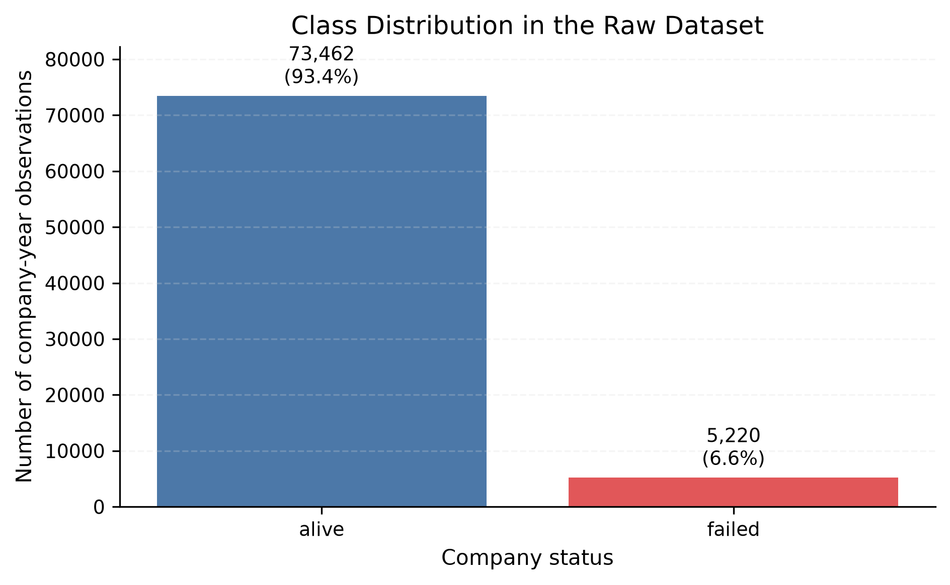
Data and Class Imbalance
78,682
company-year observations
8,971
American companies
1999–2018
sample period
6.63%
failed observations
Takeaway
A majority-only model can look accurate while detecting no failures.
Corporate Bankruptcy Risk Prediction / Berke Pehlivan / Machine Learning for Finance
3
Notes:
Timing note: 1.5 minutes.
The unit of observation is a company-year. This means that one row represents one company in one year, and the same company can appear in several years. The full sample contains 78,682 observations from 8,971 American companies between 1999 and 2018. The target is binary: alive or failed. Failed observations are the minority class, with only 6.63 percent of the sample. This imbalance is the reason why later slides focus on precision-recall performance, failed-class recall, and F1-score. Accuracy alone is not enough, because a majority-only model can achieve high accuracy while missing every failed observation.

Slide 4
Experimental Design
Full sample
78,682 observations
8,971 companies
Group split
complete companies
Training
80% companies
62,988 rows
7,176 companies
Final test
20% companies
15,694 rows
1,795 companies
Inner split
inside training
Model-fitting
50,323 rows
5,740 companies
Validation
12,665 rows
1,436 companies
Leakage control
Complete companies stay on one side of each split.
Scope
Unseen-company generalization, not future calendar forecasting.
Corporate Bankruptcy Risk Prediction / Berke Pehlivan / Machine Learning for Finance
4
Notes:
Timing note: 1.5 minutes. The project uses a company-level split because the same firm can appear in several years. If I split rows randomly, observations from one company could appear in both training and test data. That would make the evaluation too optimistic, because the model could partly learn company-specific patterns. Instead, all observations from one company stay on one side of each split. The training companies are then split again into model-fitting and validation samples. The validation sample is used for model selection and threshold analysis. The final test set remains untouched until the end. This design tests whether the models generalize to previously unseen companies. It is important to say that this is not a chronological forecast. The test companies can come from overlapping calendar years, so the project studies out-of-company generalization rather than future-period prediction.

Slide 5
Models Compared
Majority Baseline
Always predicts alive
Accuracy warning
Logistic Regression
Interpretable benchmark
L1 / L2 variants
Balanced class weights
Tree-Based Models
Decision Tree
Random Forest
Gradient Boosting
PCA Extension
PCA + Logistic Regression
Dimension reduction
Validation-only
The comparison moves from simple and interpretable methods to more flexible models.
The question is not only “which model is most complex?” — it is which trade-off is useful for screening.
Corporate Bankruptcy Risk Prediction / Berke Pehlivan / Machine Learning for Finance
5
Notes:
Timing note: 1.5 minutes. The model comparison starts with a majority baseline. It always predicts the alive class, so it is useful for showing why accuracy can be misleading. Logistic Regression is the main interpretable benchmark because its coefficients can be connected to financial variables. I also test L1 and L2 regularized versions to include the course topic of regularization. The tree-based models add flexibility. A Decision Tree is simple but can be unstable. Random Forest averages many trees, while Gradient Boosting builds trees sequentially. Gradient Boosting was selected by validation PR-AUC. PCA with Logistic Regression is included as an extension, not as the main model. Its purpose is to test whether the financial variables can be compressed without losing much predictive information. The key point is that model choice depends on the objective.

Slide 6
Evaluation Strategy
Why accuracy is not enough
A model can look accurate by predicting almost every observation as alive.
Model selection
Validation PR-AUC
= average precision
Thresholds
Lower threshold → more failures detected, but more false alarms.
Failed recall
Share of actual failures detected
Failed precision
Share of failure alerts that are correct
Failed F1
Balance between recall and precision
Balanced accuracy
Equal weight to both classes
Ranking metrics and threshold-based classifications answer different questions.
Corporate Bankruptcy Risk Prediction / Berke Pehlivan / Machine Learning for Finance
6
Notes:
Timing note: 1.5 minutes. Ordinary accuracy is not enough in this project because failed observations are rare. A model can classify most alive observations correctly and still miss the failed class. Recall tells us how many actual failures are detected, which matters for screening. Precision tells us how many failure alerts are correct, which matters because false alarms create review costs. F1 combines precision and recall into one operating-point measure. PR-AUC measures ranking quality for the failed class across thresholds, and in the project outputs it is scikit-learn average precision. Balanced accuracy is a secondary metric because it gives equal weight to both classes. Thresholds are treated separately. Lower thresholds usually detect more failures, but they also create more false alarms. The threshold scenarios use validation predictions only; the main final-test comparison keeps the default prediction rule.

Slide 7
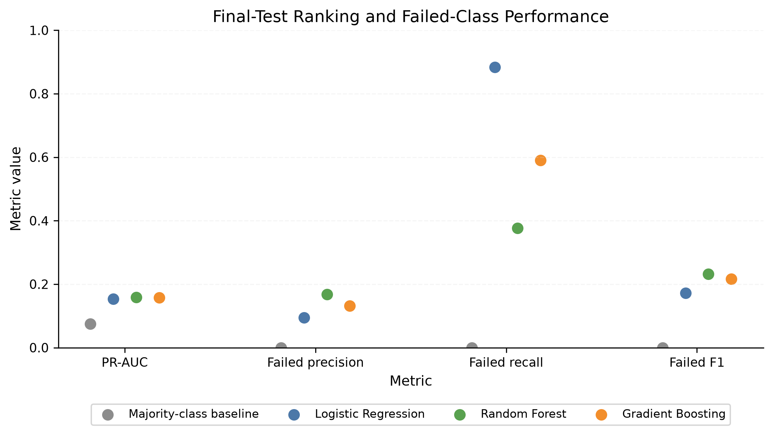
Main Final-Test Results
Baseline warning
92.5% accuracy, but detects no failures.
Broad screening
Logistic Regression recall = 0.884, but precision = 0.095.
Metric-dependent result
Random Forest has highest observed PR-AUC/F1; Gradient Boosting is validation-selected.
No model is strongest on every measure.
Corporate Bankruptcy Risk Prediction / Berke Pehlivan / Machine Learning for Finance
7
Notes:
Timing note: 2.0 minutes.

Slide 8
Classification Trade-Offs
Default prediction rule: more detected failures usually means more false alarms.
Model
Detected failures
Missed failures
False alarms
Interpretation
Logistic Regression
1,041
136
9,906
Broad screen Many false alerts
Random Forest
442
735
2,190
More selective Fewer alerts
Gradient Boosting
695
482
4,563
Middle position Validation-selected
Financial question
Which error is more costly: a missed failure or a false alarm?
Important caveat
Financial costs and review capacity are not estimated here.
Corporate Bankruptcy Risk Prediction / Berke Pehlivan / Machine Learning for Finance
8
Notes:
Timing note: 2.0 minutes.

Slide 9
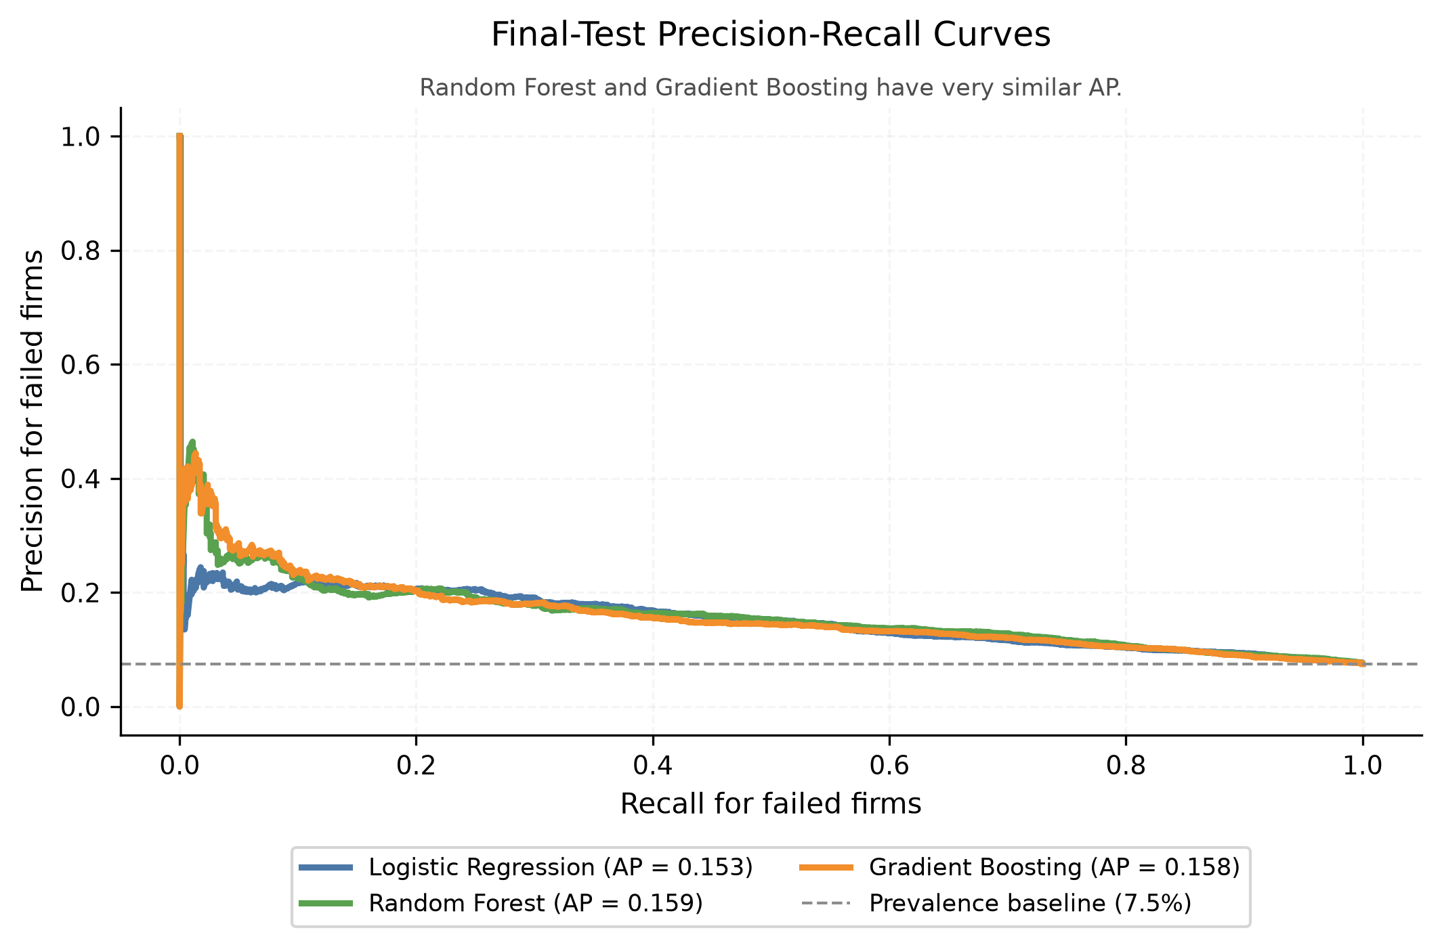
Precision–Recall Interpretation
Rare-event ranking
PR curves focus on the failed class, not the many alive observations.
Average precision
RF 0.159
GB 0.158
LR 0.153
Key interpretation
Ranking is similar, but default-threshold behavior differs strongly.
Corporate Bankruptcy Risk Prediction / Berke Pehlivan / Machine Learning for Finance
9
Notes:
Timing note: 1.5 minutes.

Slide 10
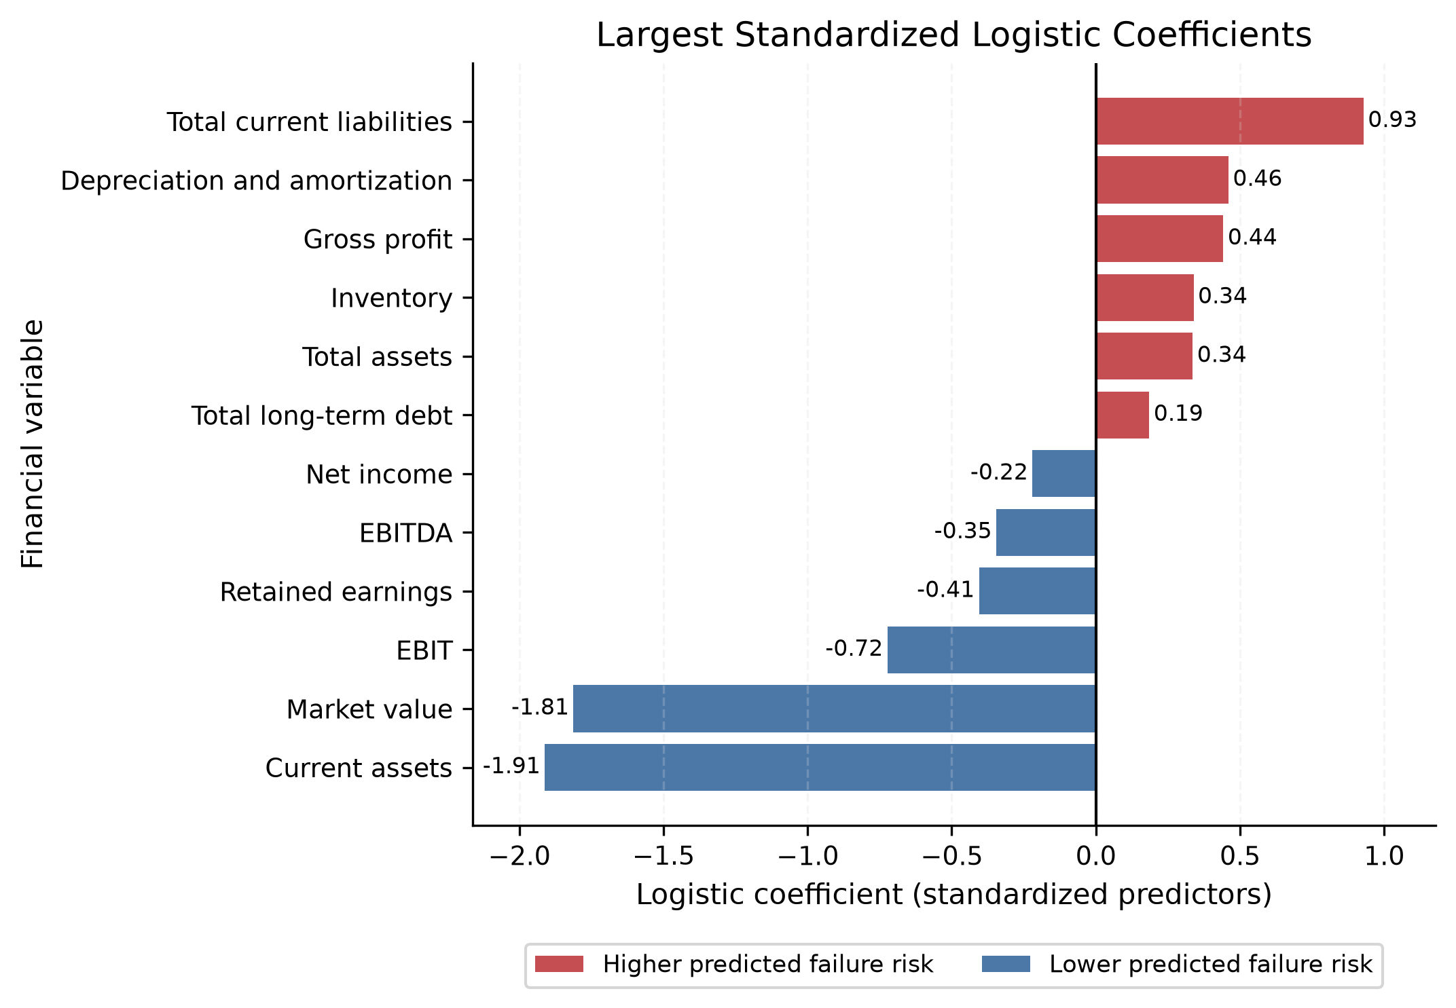
Model Interpretation
Signed interpretation
Positive coefficients → higher predicted failure log-odds. Negative coefficients → lower.
Largest negative signals
Current assets −1.912
Market value −1.812
Caution
Coefficients and tree importance are predictive interpretations, not causal evidence.
Corporate Bankruptcy Risk Prediction / Berke Pehlivan / Machine Learning for Finance
10
Notes:
Timing note: 1.75 minutes.

Slide 11
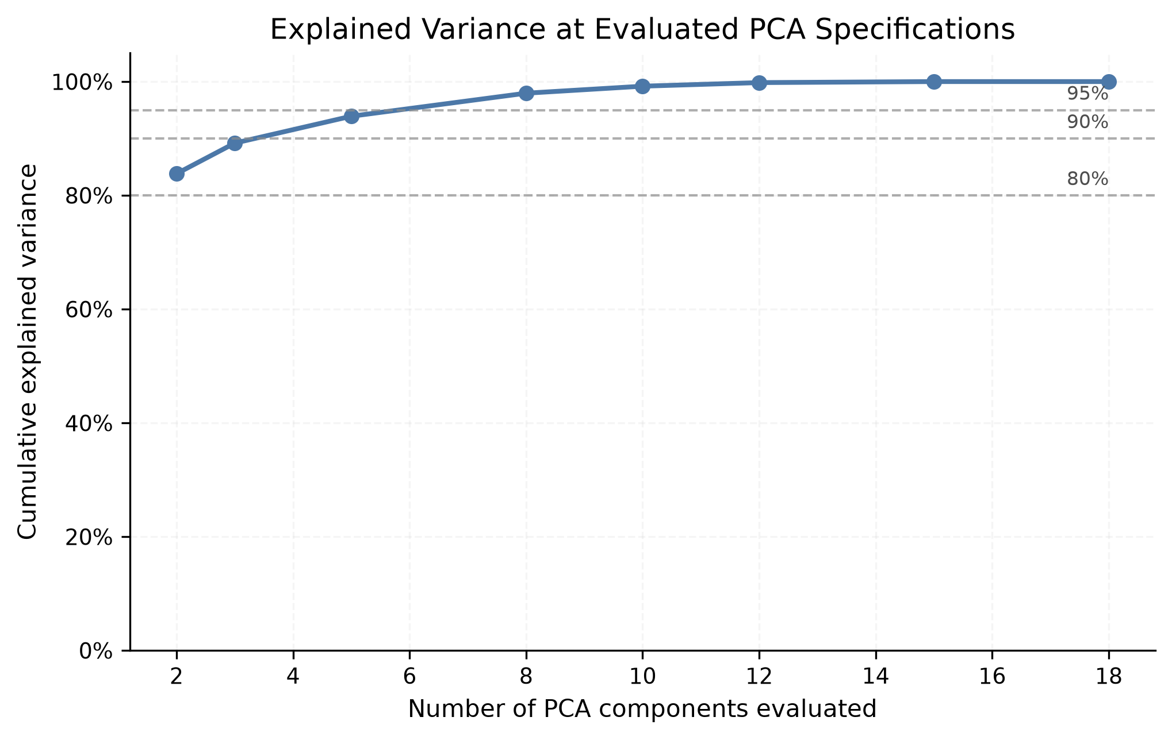
PCA Extension
Compression works mechanically
2 components retain 83.8% of variance; 10 retain 99.2%.
But prediction is different
Explained variance is not the same as classification performance.
Validation result
PCA with 10–12 components is similar, not clearly better, than original Logistic Regression.
Interpretability cost
Components mix many accounting variables.
Corporate Bankruptcy Risk Prediction / Berke Pehlivan / Machine Learning for Finance
11
Notes:
Timing note: 1.25 minutes.

Slide 12
Limitations and Conclusion
What the project shows
Financial variables contain useful screening and ranking information.
What it does not show
No causal effects, no calibrated probabilities, no production-ready decision rule.
Main limitation
Not a chronological forecasting backtest.
Final answer: bankruptcy-risk classification remains difficult, and model choice depends on the screening objective.
• Define a forward failure horizon • Evaluate chronologically and estimate uncertainty • Choose thresholds using financial costs and review capacity
Corporate Bankruptcy Risk Prediction / Berke Pehlivan / Machine Learning for Finance
12
Notes:
Timing note: 2.0 minutes.

Slide 13
Thank you.
Questions and discussion
Berke Pehlivan

Slide 14
Backup: Model Specifications
Compact grids were used to compare model families, not to run a large optimization exercise.
Majority
always alive
Logistic
L2, C=1, balanced weights
L1 / L2 LR
C=0.1, balanced weights
Decision Tree
depth 5, min leaf 50
Random Forest
300 trees, min leaf 50
Gradient Boosting
150 trees, lr 0.05, depth 3
PCA + LR
2–18 components, validation-only
Corporate Bankruptcy Risk Prediction / Berke Pehlivan / Machine Learning for Finance
14

Slide 15
Backup: Complete Final-Test Metrics
Model
Acc.
Bal. acc.
ROC-AUC
PR-AUC
Fail recall
Fail F1
Majority
0.925
0.500
0.500
0.075
0.000
0.000
Logistic Regression
0.360
0.601
0.690
0.153
0.884
0.172
Random Forest
0.814
0.612
0.699
0.159
0.376
0.232
Gradient Boosting
0.679
0.638
0.688
0.158
0.590
0.216
Main deck uses the key models only; this table shows the full saved comparison.
Corporate Bankruptcy Risk Prediction / Berke Pehlivan / Machine Learning for Finance
15

Slide 16
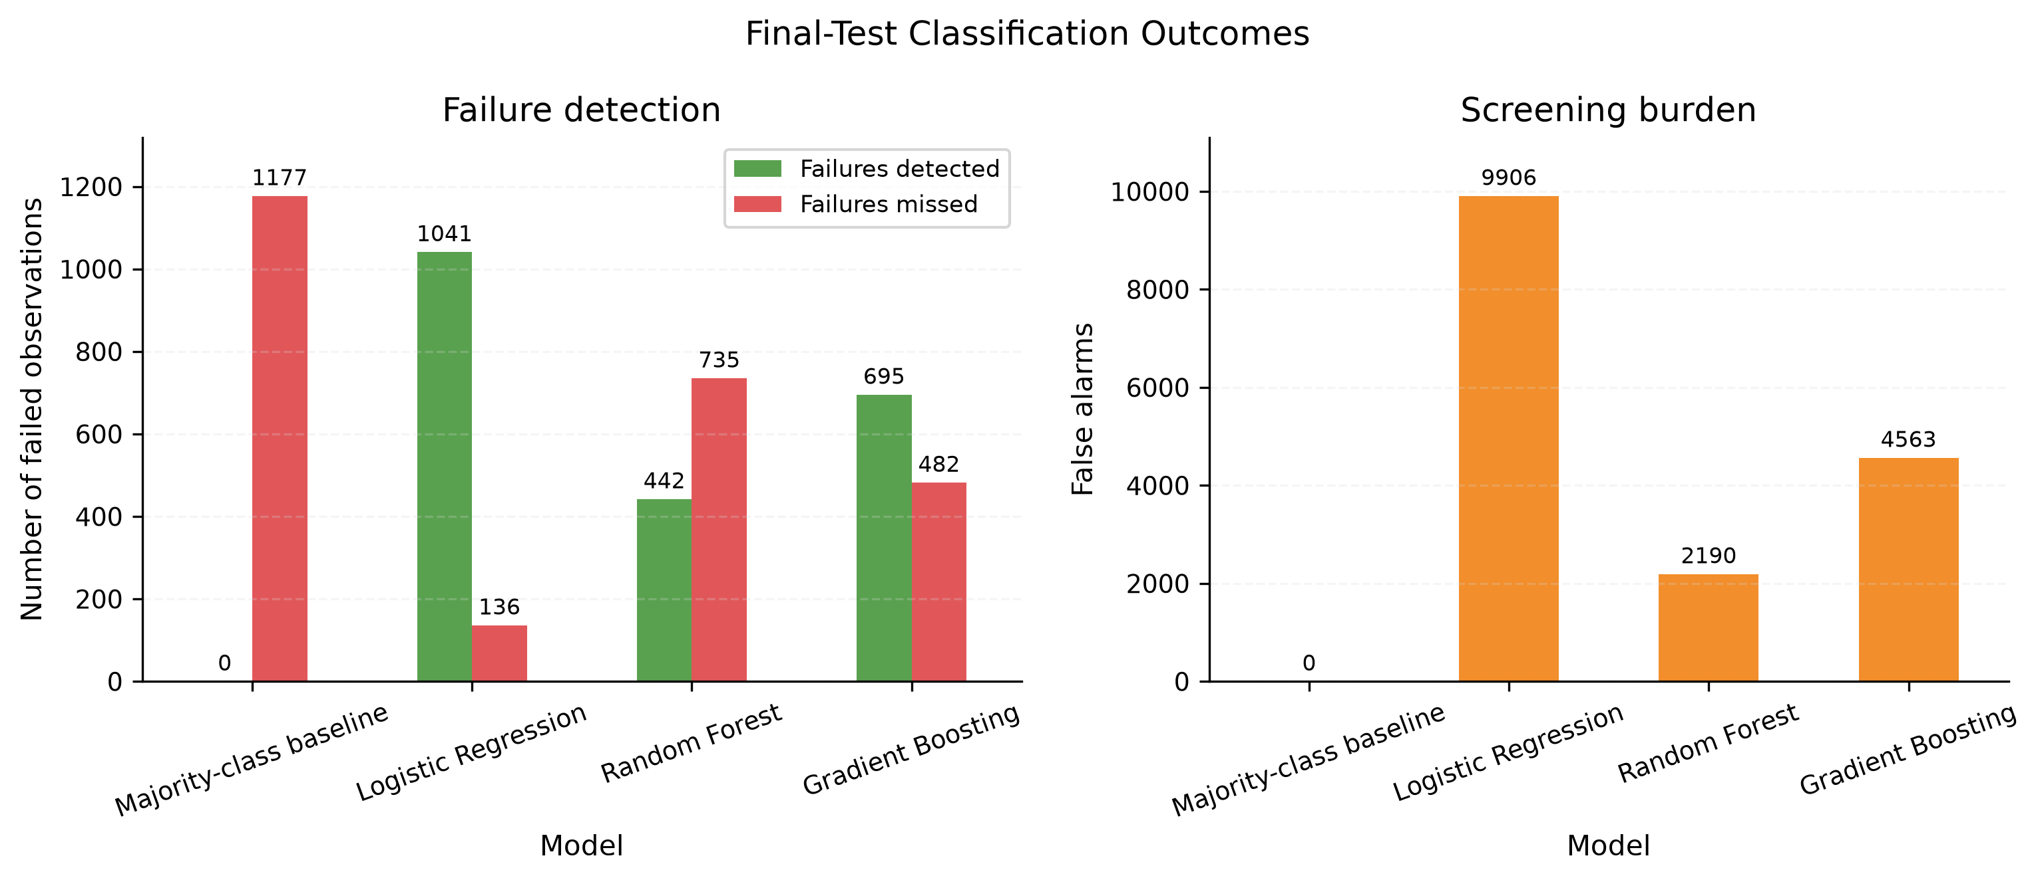
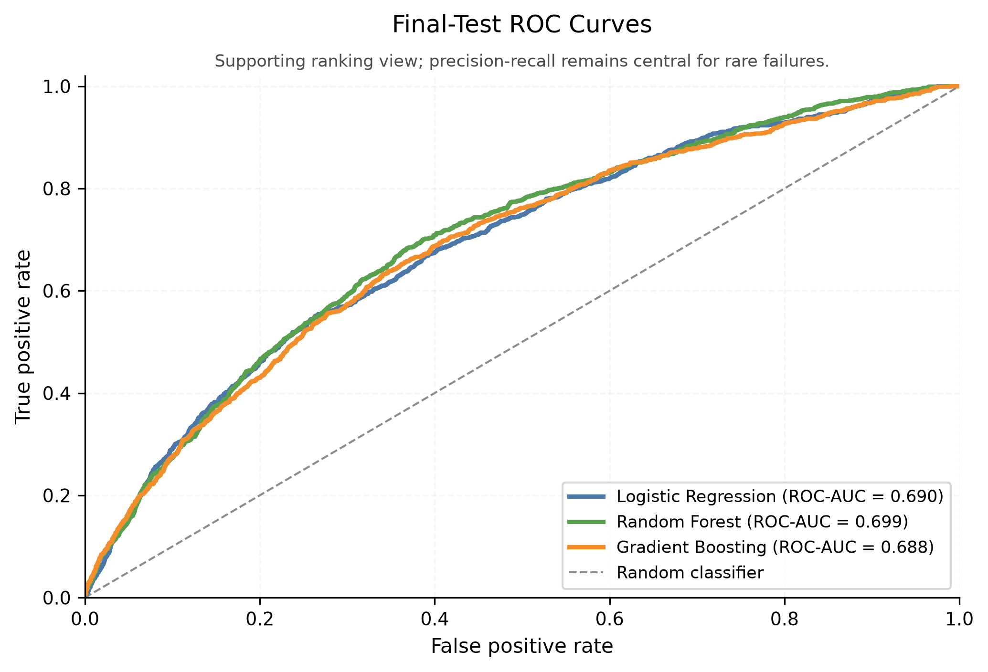
Backup: Validation Threshold Scenarios
Threshold question
How much review burden is acceptable if recall is increased?
Why ROC is backup
ROC-AUC is useful, but PR curves show rare-failure screening burden more directly.
Corporate Bankruptcy Risk Prediction / Berke Pehlivan / Machine Learning for Finance
16

Slide 17
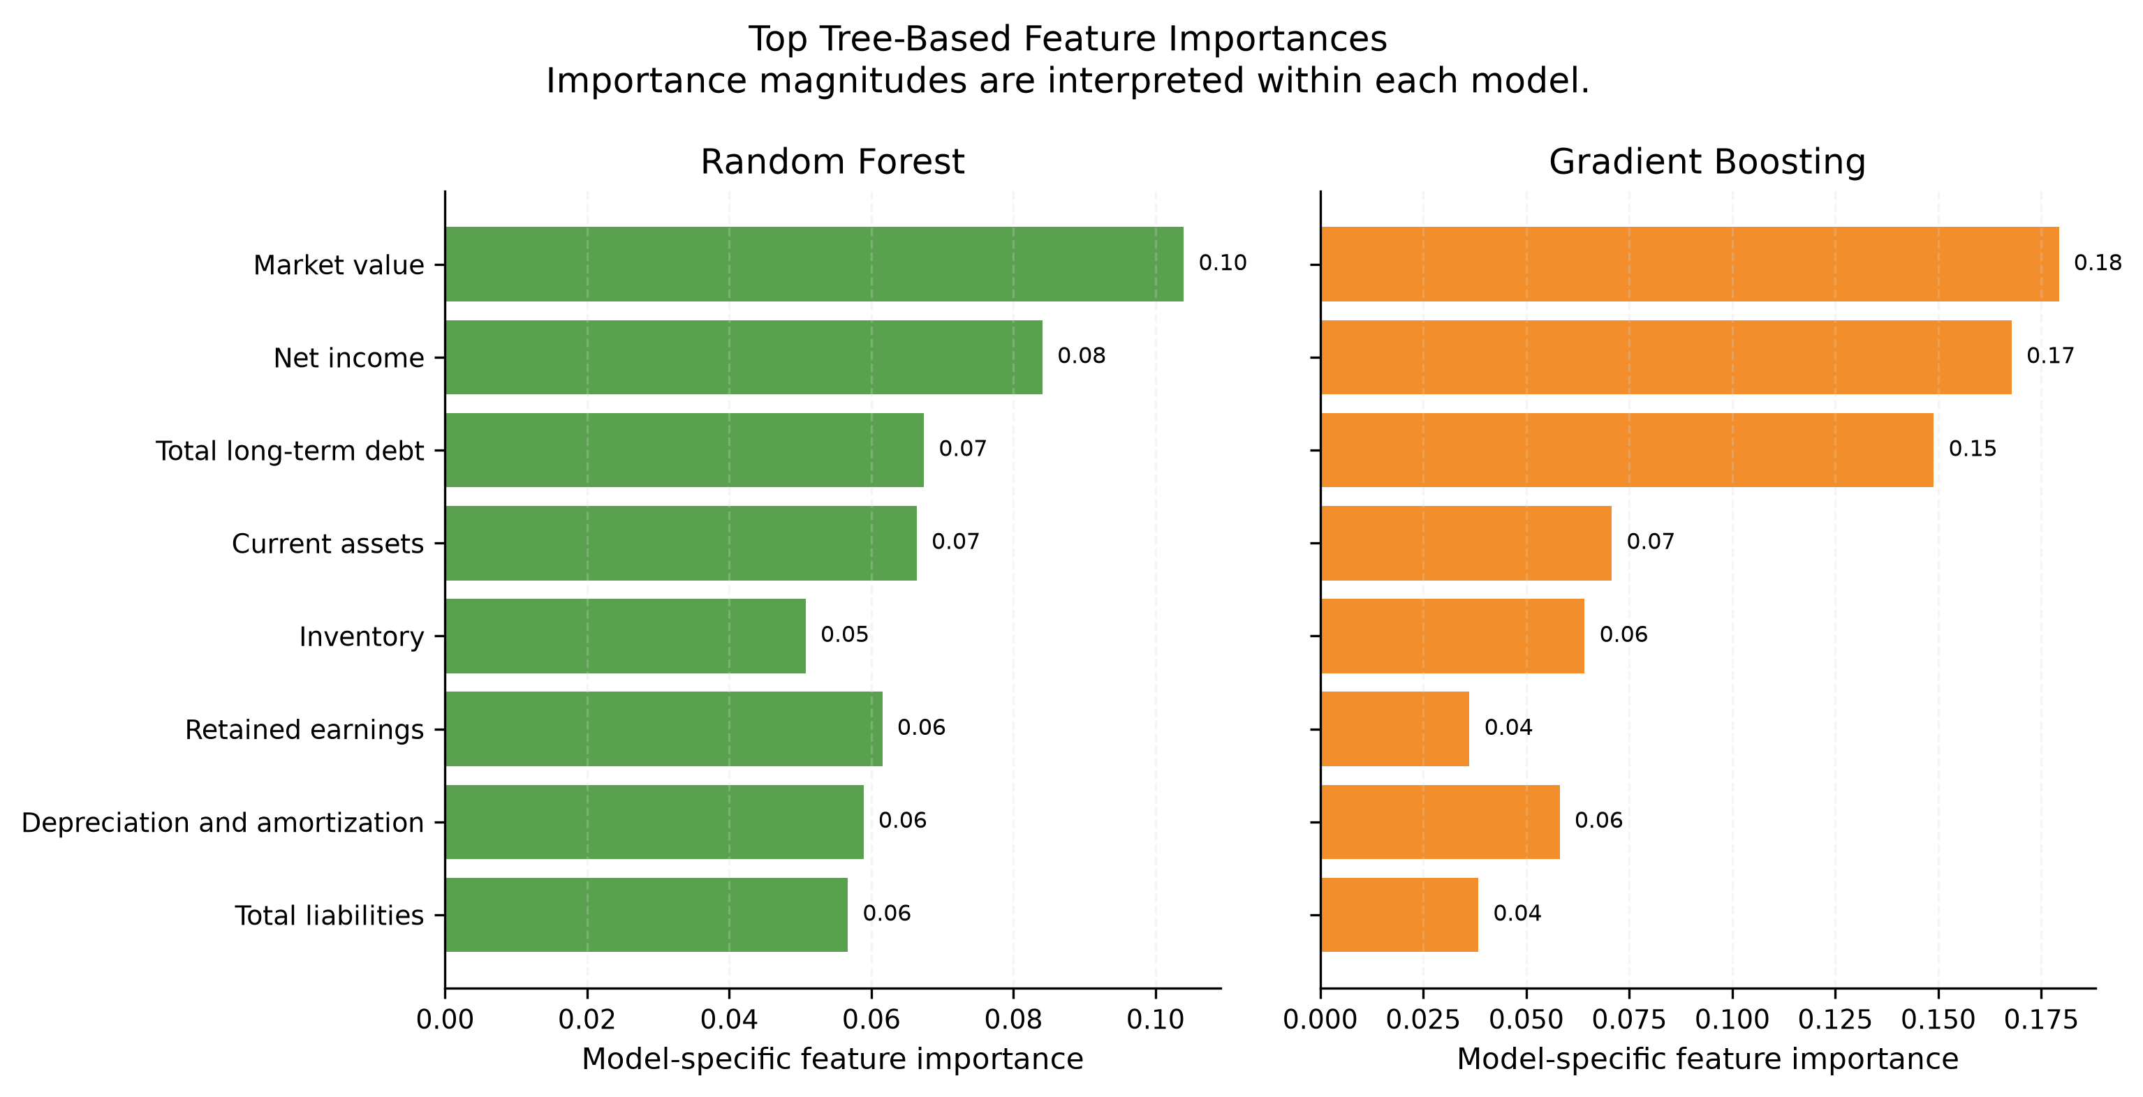
Backup: Tree-Based Feature Importance
Top features
Market value, net income, and long-term debt are important in both ensembles.
Interpretation limit
Importance does not show direction and is not causal.
Use in discussion
Helpful if asked why tree models made their predictions.
Corporate Bankruptcy Risk Prediction / Berke Pehlivan / Machine Learning for Finance
17

Slide 18
Backup: Reproducible Implementation
Task workflow
pytask connects preprocessing, modelling, evaluation, figures, and paper outputs.
Environment
Pixi fixes Python dependencies and commands.
Tests
26 tests check main data and modelling behavior.
pixi run build pixi run test
Generated outputs are saved under data/processed/ and outputs/. The paper-ready layer contains summaries derived from the same model run.
Corporate Bankruptcy Risk Prediction / Berke Pehlivan / Machine Learning for Finance
18

